Slide 1

Instructions and instruction sequencing in Computer organization

Slide 2

INSTRUCTIONS & INSTRUCTION SEQUENCING
The tasks carried out by a computer program consist of a sequence of small steps, such as adding two numbers, testing for a particular condition, reading a character from the keyboard, or sending a character to be displayed on a display screen.

Slide 3

A computer must have instructions capable of performing 4 types of operations:
1) Data transfers between the memory and the registers (MOV, PUSH, POP, XCHG).
2) Arithmetic and logic operations on data (ADD, SUB, MUL, DIV, AND, OR, NOT).
3) Program sequencing and control(CALL.RET, LOOP, INT).
4) I/0 transfers (IN, OUT).

Slide 4

REGISTER TRANSFER NOTATION (RTN)
Here we describe the transfer of information from one location in a computer to another. Possible locations that may be involved in such transfers are memory locations, processor registers, or registers in the I/O subsystem. Most of the time, we identify such locations symbolically with convenient names.
• The possible locations in which transfer of information occurs are:
1) Memory-location
2) Processor register &
3) Registers in I/O device

Slide 5
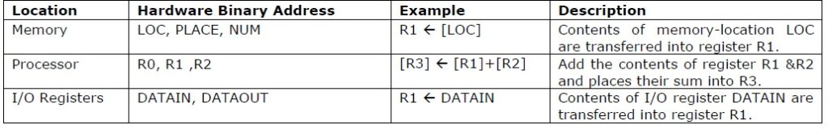

Slide 6
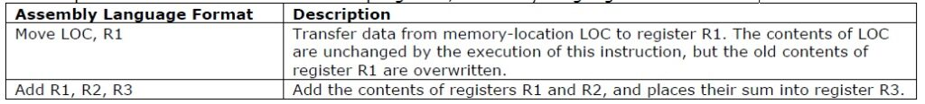
ASSEMBLY LANGUAGE NOTATION
To represent machine instructions and programs, assembly language format is used

Slide 7
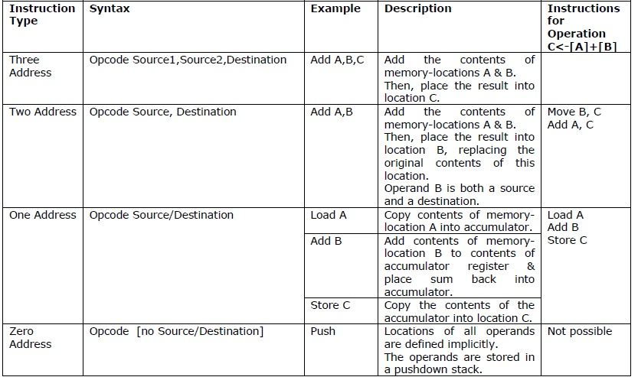
BASIC INSTRUCTION TYPES

Slide 8
INSTRUCTION EXECUTION & STRAIGHT LINE SEQUENCING
1) Initially, the address of the first instruction is loaded into PC (Figure 2.8).
2) Then, the processor control circuits use the information in the PC to fetch and execute instructions, one at a time, in the order of increasing addresses. This is called Straight-Line sequencing.
3) During the execution of each instruction, PC is incremented by 4 to point to next instruction.

Slide 9
There are 2 phases for Instruction Execution:
1) Fetch Phase: The instruction is fetched from the memory-location and placed in the IR.
2) Execute Phase: The contents of IR is examined to determine which operation is to be performed. The specified-operation is then performed by the processor

Slide 10
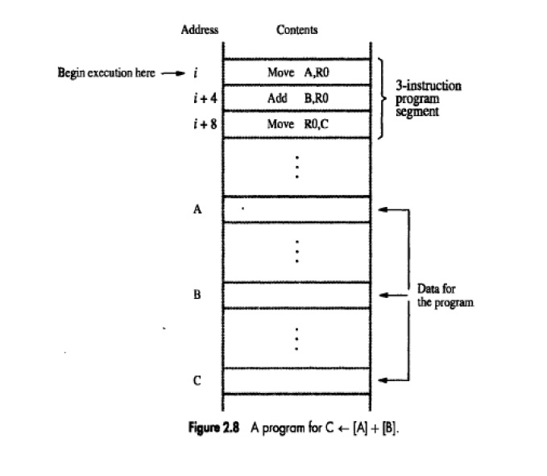

Slide 11

Program Explanation
• Consider the program for adding a list of n numbers (Figure 2.9).
• The Address of the memory-locations containing the n numbers are symbolically given as NUM1, NUM2…..NUMn.
• Separate Add instruction is used to add each number to the contents of register R0.
• After all the numbers have been added, the result is placed in memory-location SUM.

Slide 12
